Slide 1
Dockerfile

Slide 2
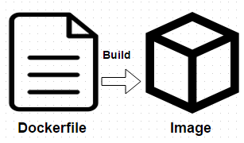
Dockerfile
Dockerfile is nothing but the source code for building Docker images
Create images automatically using a build script “Dockerfile”
Can be versioned in a version control system like Git or SVN along with all dependencies
Docker hub can automatically build images based on dockerfiles on Github

Slide 3
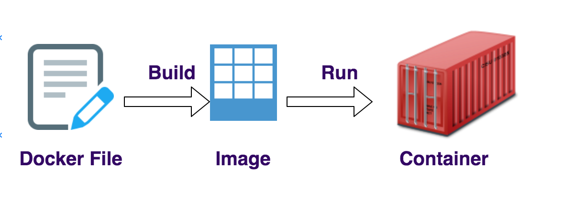
Dockerfile Example:
FROM nginx:alpine
COPY index.html /usr/share/nginx/html/index.html
Index.html:
<h1> Hello !!!!!</h1>
<p>This is a simple static website being served from Nginx running inside a Docker container !!</p>
Command to build docker image,
$ docker build –t myweb .
Command to view builded image
$ docker images
Command to run a container out of the image
$ docker run –d –p 80:80 myweb

Slide 4
Docker images
Docker images are the read only templates from which the containers are launched from
Each image consists of a series of layers using the union file system
When a image is changed a new layer will be created

Slide 5
Dockerfile instructions
FROM
The FROM command sets the base image for the rest of the instructions and it will be the first instruction in Dockerfile
It is used to specify the valid docker image name. So specified Docker Image will be downloaded from docker hub registry if it is not exists locally
Example: FROM nginx:latest

Slide 6
Dcokerfile instructions (cont..)
LABEL
LABEL instruction is used to specify metadata informations to an image and is a key-value pair
Example: LABEL "Application_Environment"="Development"

Slide 7
Dockerfile instructions (cont..)
EXPOSE
EXPOSE instruction is used to inform about the network ports that the container listens on runtime. Docker uses this information to interconnect containers using links and to set up port redirection on docker host system
Example: EXPOSE 80

Slide 8
Dockerfile instructions (cont..)
ADD
ADD instruction is used to copy files, directories and remote URL files to the destination (docker container) within the filesystem of the Docker Images
Example: ADD ["src","dest"]
ADD /root/testfile /data/
If the "src" argument is a compressed file (tar, gzip, bzip2, etc) then it will extract at the specified "dest" in the container's filesystem

Slide 9
Dockerfile instructions (cont..)
COPY
COPY instruction is used to copy files, directories and remote URL files to the destination within the filesystem of the Docker Images
Example: COPY src dest COPY /root/testfile /data/

Slide 10
Dockerfile instructions (cont..)
RUN
RUN instruction is used to executes any commands on top of the current image and this will create a new laye
Example: RUN apt-get update
CMD
CMD instruction is used to set a command to be executed when running a container. There must be only one CMD in a Dockerfile
If more than one CMD is listed, only the last CMD takes effect
Example: CMD ping google.com

Slide 11
Dockerfile instructions (cont..)
ENTRYPOINT
ENTRYPOINT instruction is used to configure and run a container as an executable
Example: ENTRYPOINT ping google.com
ENTRYPOINT ["ping","google.com"] - in executable form
WORKDIR
WORKDIR instruction is used to set the working directory
Example: WORKDIR src /app

Slide 12
Dockerfile instructions (cont..)
ENV
ENV instruction is used to set environment variables with key and value
Example: ENV app_version 2.0
ENV APP_DIR /data/
ARG
ARG instruction is also used to set environment variables with key and value, but this variables will set only during the image build not on the container
Example: ARG TMP_VER 2.0

Slide 13
TAHNK YOU

